Slide 1
Listen with Our Whole Body

Slide 2
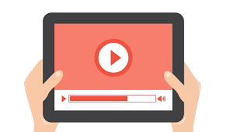
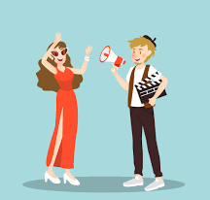

Plans for today
Watch a video Act it out Make a craft

Slide 3
Which parts of your body are for listening?

Slide 4
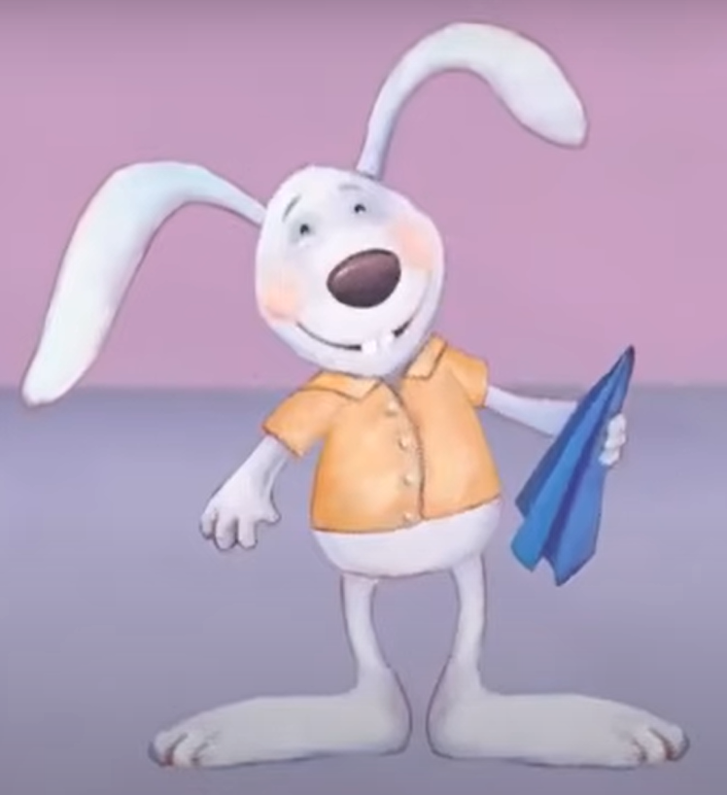
Watch a video about Howard B.Wigglebottom

Slide 5
Which parts of your body are for listening?

Slide 6
Use our ears when listening

Slide 7
Use our face when listening

Slide 8
Use our eyes when listening

Slide 9
Use our mouth when listening

Slide 10
Use our hands when listening

Slide 11
Use our feet when listening

Slide 12
Use our brain when listening

Slide 13
Use our heart when listening

Slide 14

Bunny ear headband

Slide 15




Expected behaviors
Watch Listen Work Ask for help

